Slide 1


School-to-infrastructure mapping work BRAZIL
July 2022

Slide 2
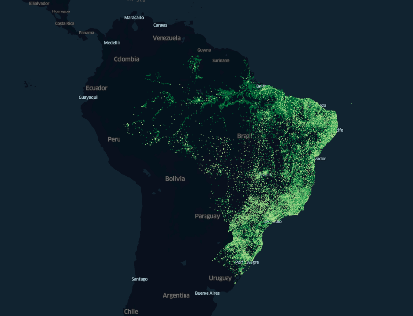
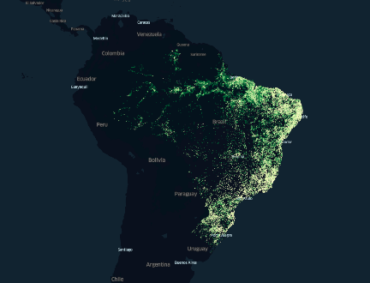
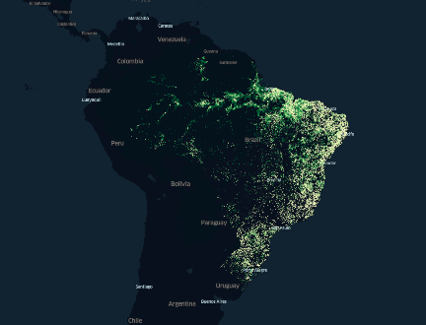
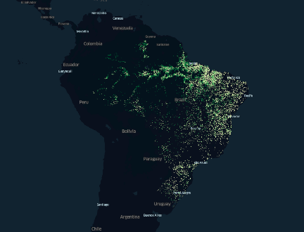
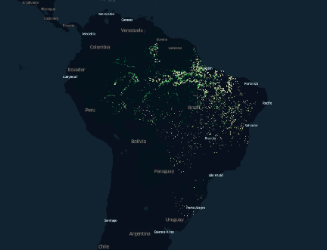
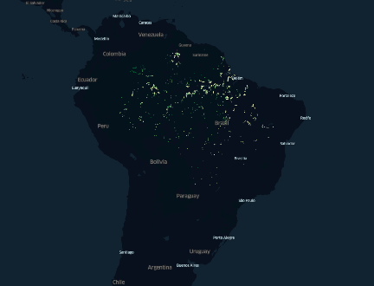
Remoteness of schools from ICT infrastructure
All schools
> 2 km
> 5 km
> 10 km
> 20 km
> 40 km

Slide 3
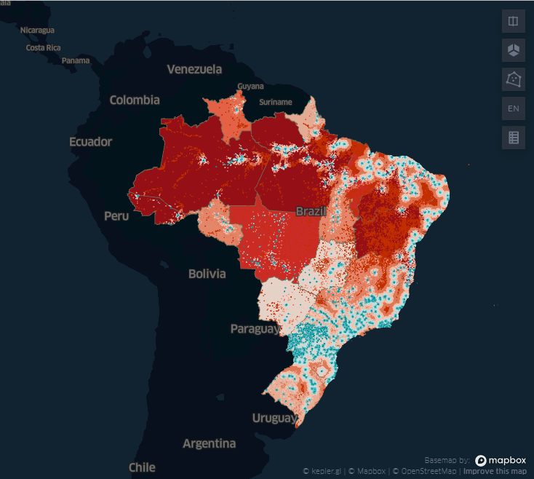
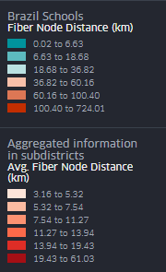
Infrastructure Map
Use Cases
Available connectivity options and at school locations.
Close to optimal ways to connect schools to fiber optical network.
Schools covered with 4G.
Schools located close to fiber nodes and cell towers.
School categories to be selected for pilot project activities.
Schools (or regions) that require less/more investment than others.
Link to the infrastructure map example

Slide 4
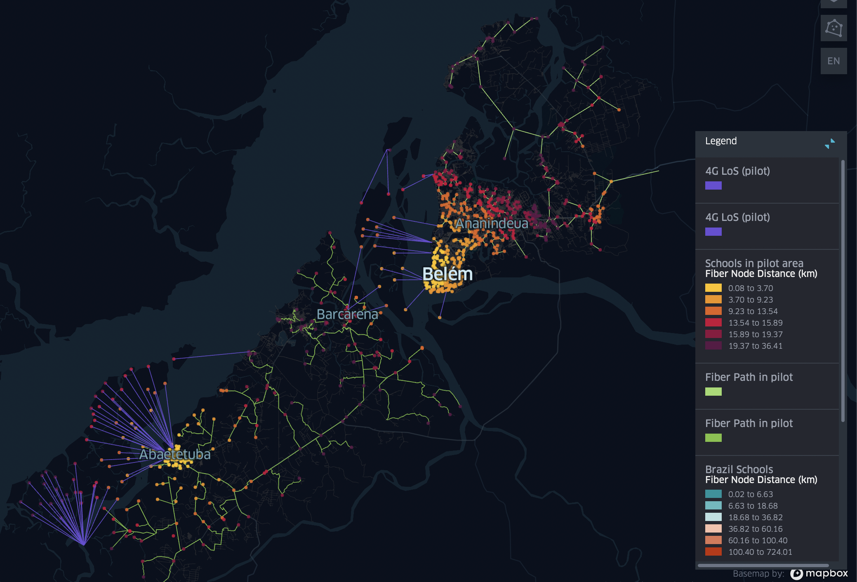
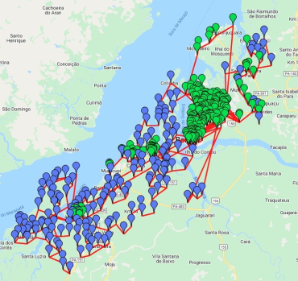
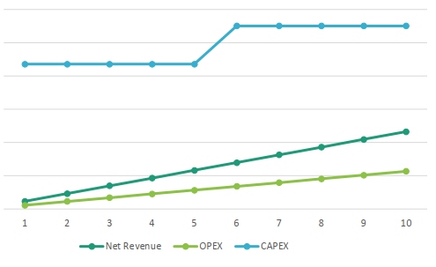
Business Planning (Pilot)
ITU and MegaEdu chose the settlement of Belem from Para state for possible collaboration on connectivity and cost models.
Infrastructure Business Planning Toolkit: demand, revenue, CapEx, OpEx, NPV.

Slide 5

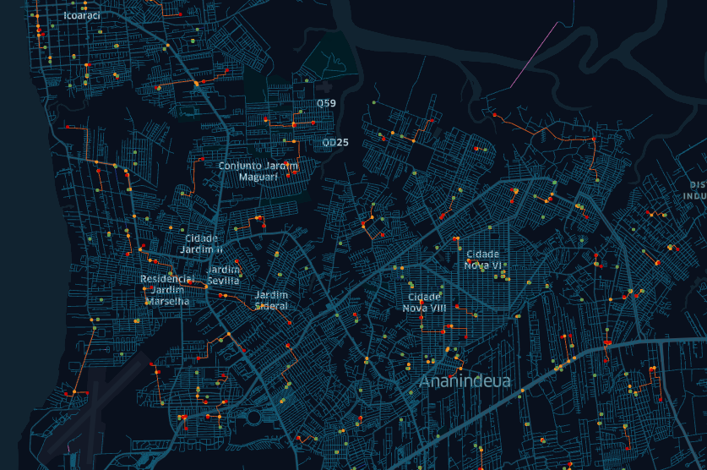
Fiber path model
Pipeline:
Input data
Clustering
Calculating MST
Merging
Extracting shortest paths
Identifying branching points
Calculating distances
Feeding the distances into economic model

Slide 6
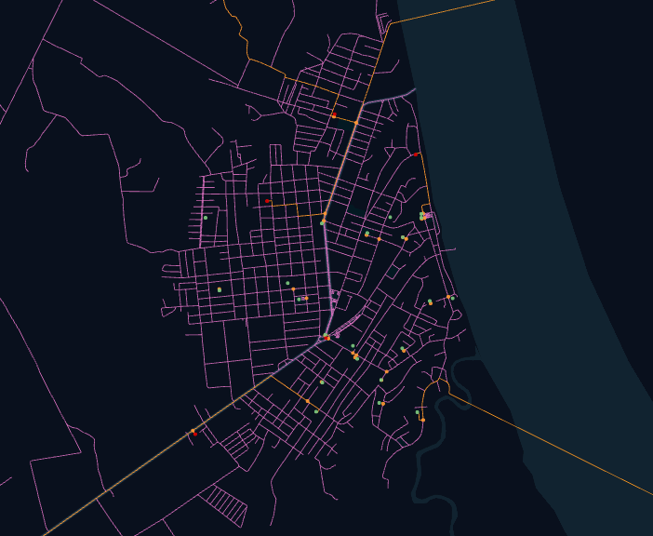
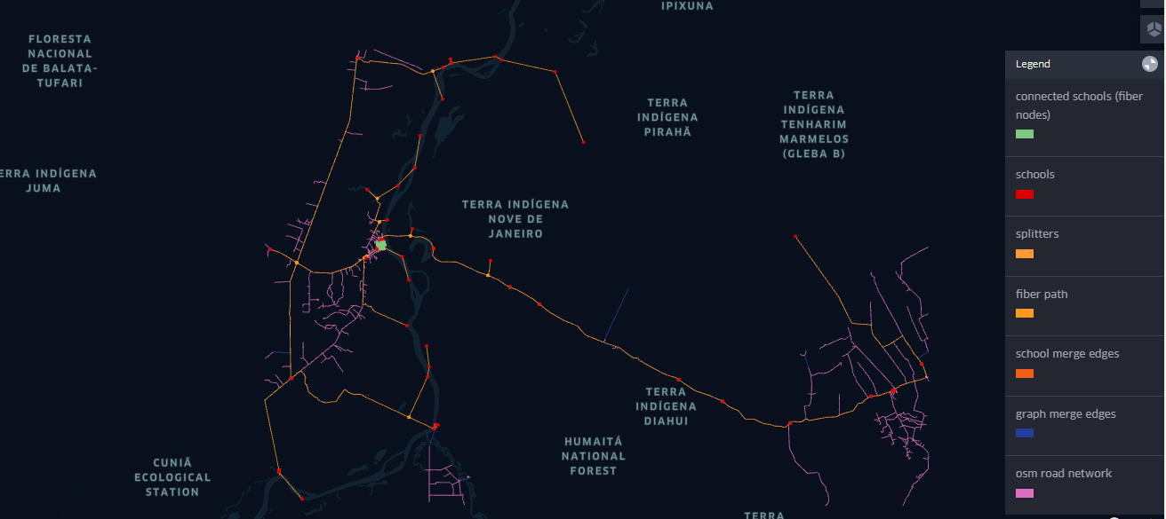
Fiber path model
school_code | distance_to_fiber_node | osm_part_of_distance | closest_fiber_node_id | path | closest_vertice_id | closest_vertice_distance
11001798 | 126538.909 | 102252.859 | 13051202 | [11001798, 'intersect_11003413', 3756074863, 'intersect_13078186', 4548048687, 4582282869, 324957536, 3007864333, 'intersect_13105833', 2125726041, 13051202] | intersect_11003413 | 953.695

Slide 7
Next steps
Calculate routes between schools and fiber points for the whole Brazil.
Identify alternative technologies to connect schools where fiber connection is not viable.
Provide cost estimates to connect schools with fiber and alternative technologies.

